Slide 1
IP Subnetting – Zero to Hero Fixed-Length Subnet Mask (FLSM)
CyberQuince

Slide 2
Fixed-Length Subnet Mask (FLSM)
Fixed-length means that every subnet in your network will have the same mask.

Slide 3
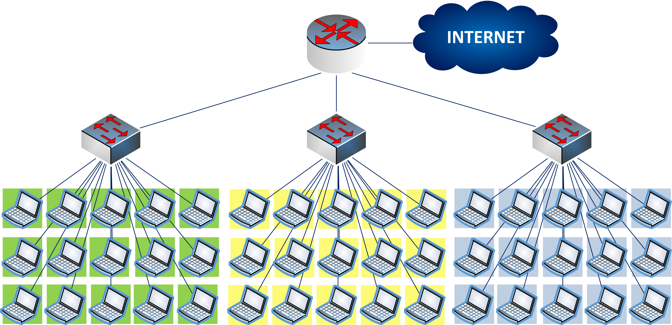
Fixed-Length Subnet Mask (FLSM)

Slide 4
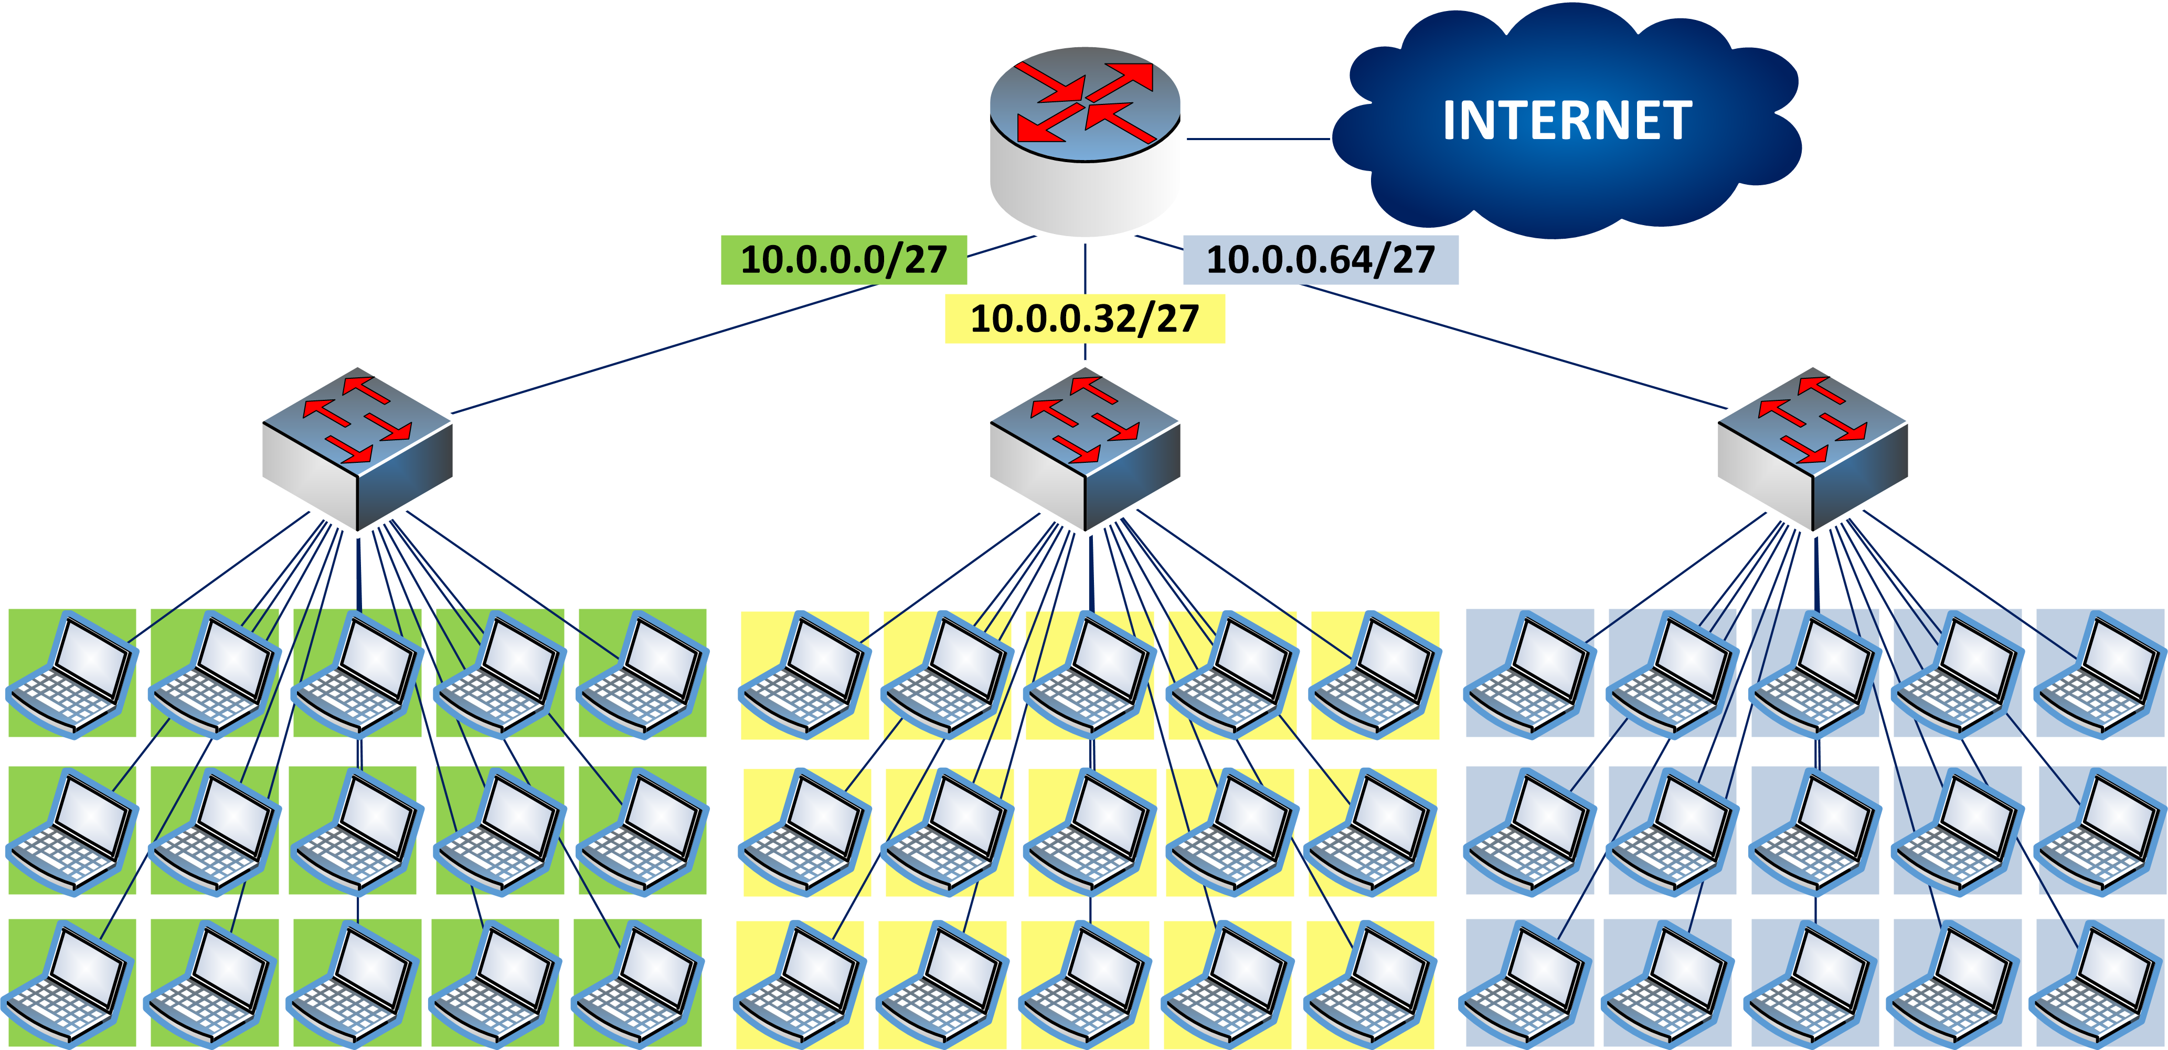
Fixed-Length Subnet Mask (FLSM)

Slide 5
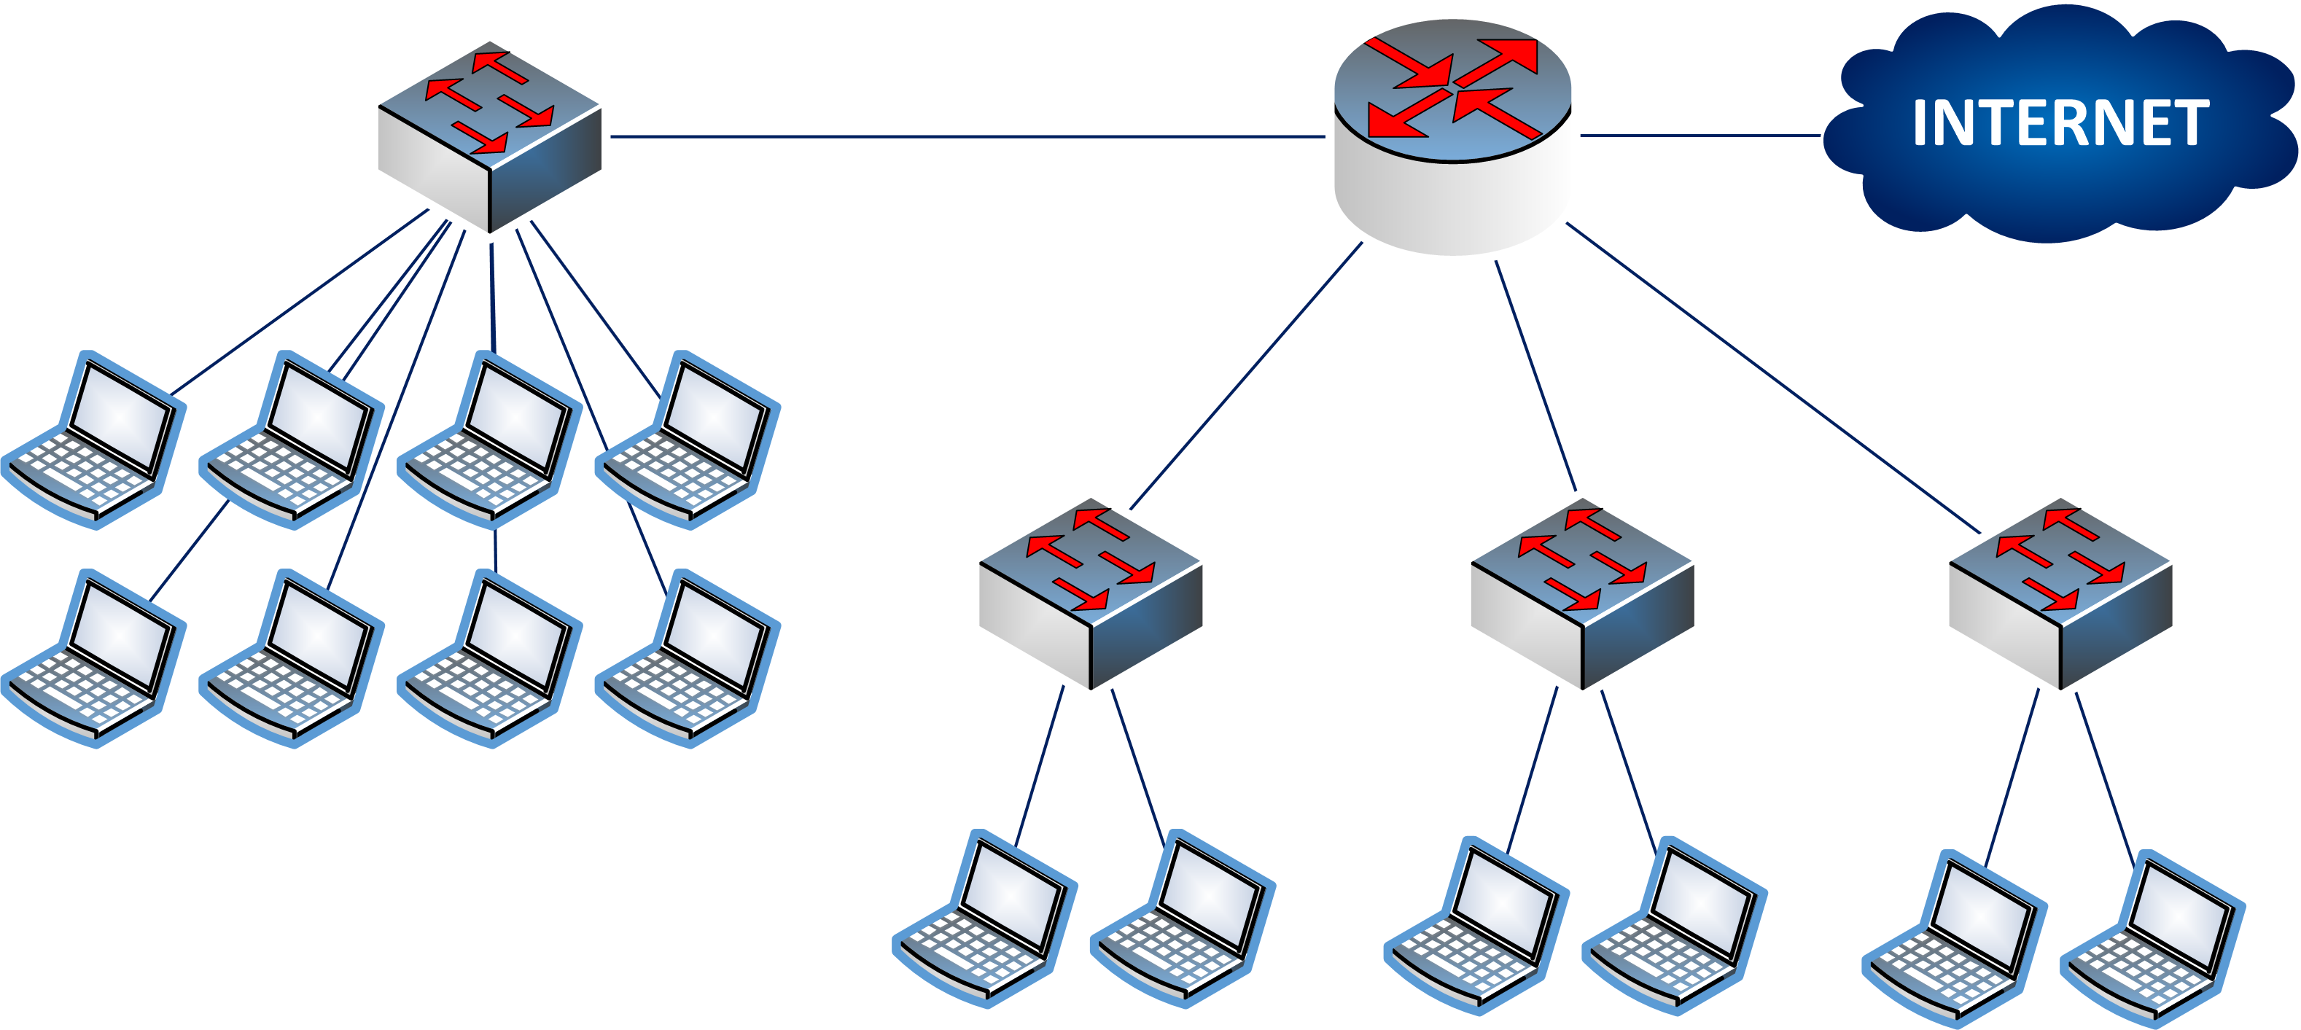
A Simple Example
192.168.1.0

Slide 6
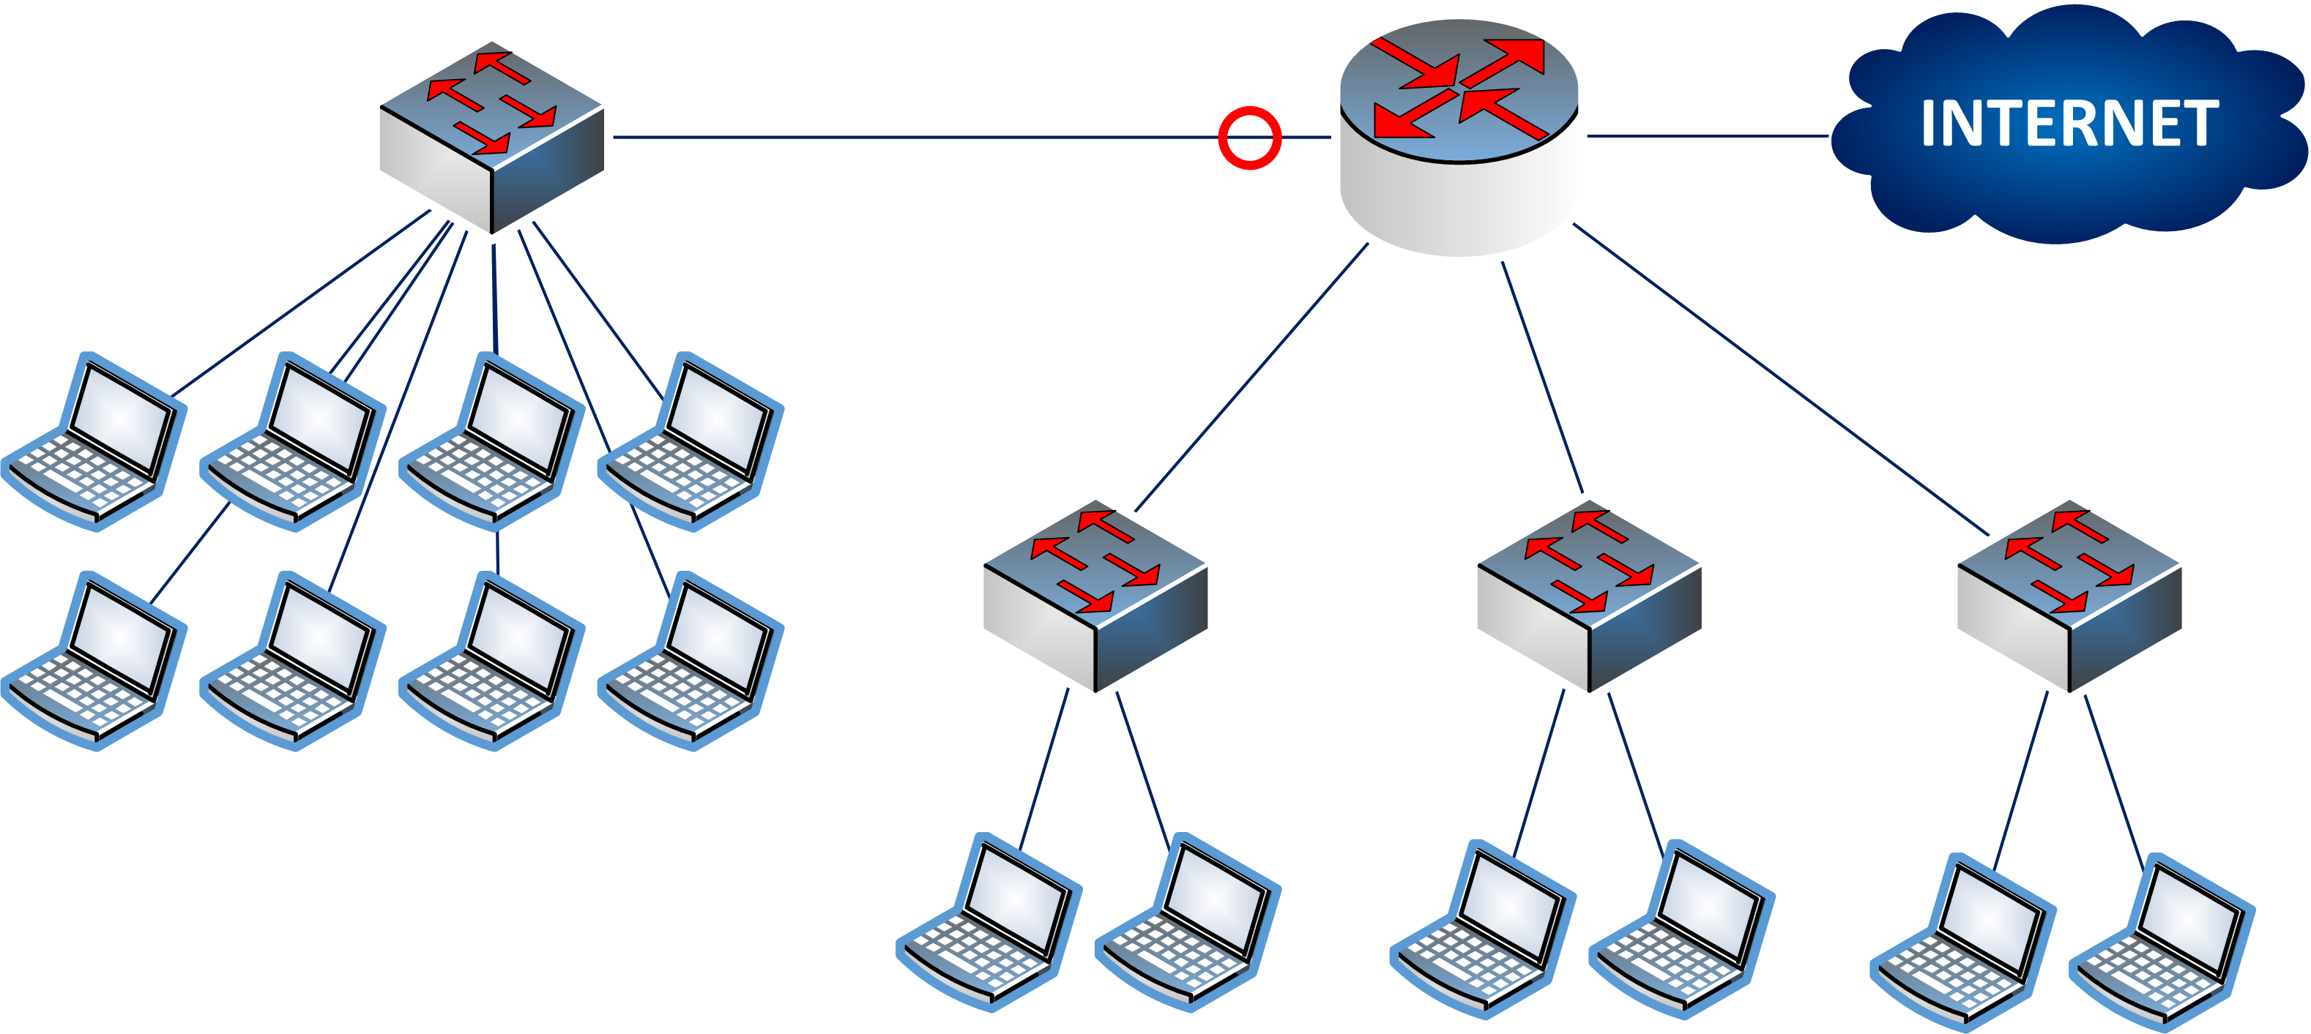
A Simple Example

Slide 7

A Simple Example

Slide 8

A Simple Example

Slide 9

A Simple Example

Slide 10
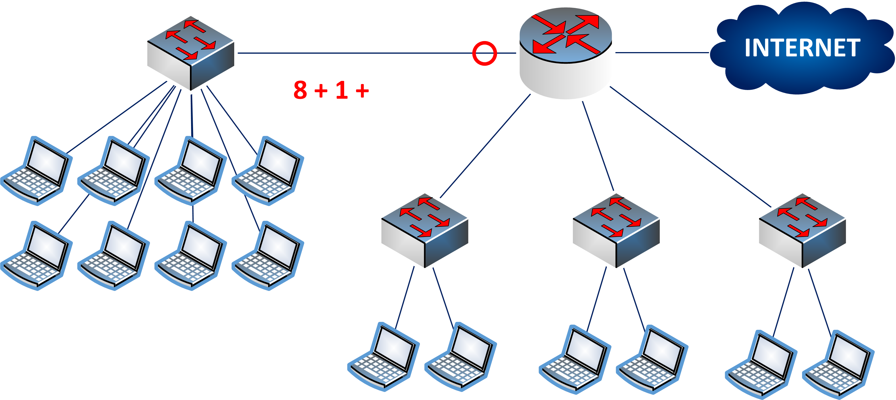
A Simple Example

Slide 11

A Simple Example

Slide 12

A Simple Example

Slide 13
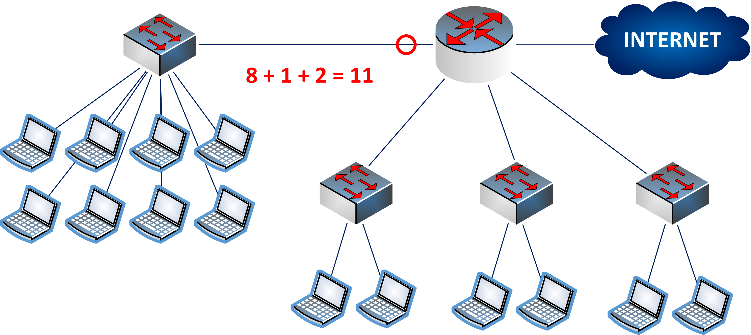
A Simple Example

Slide 14

A Simple Example

Slide 15

A Simple Example

Slide 16

A Simple Example

Slide 17

A Simple Example

Slide 18

A Simple Example

Slide 19
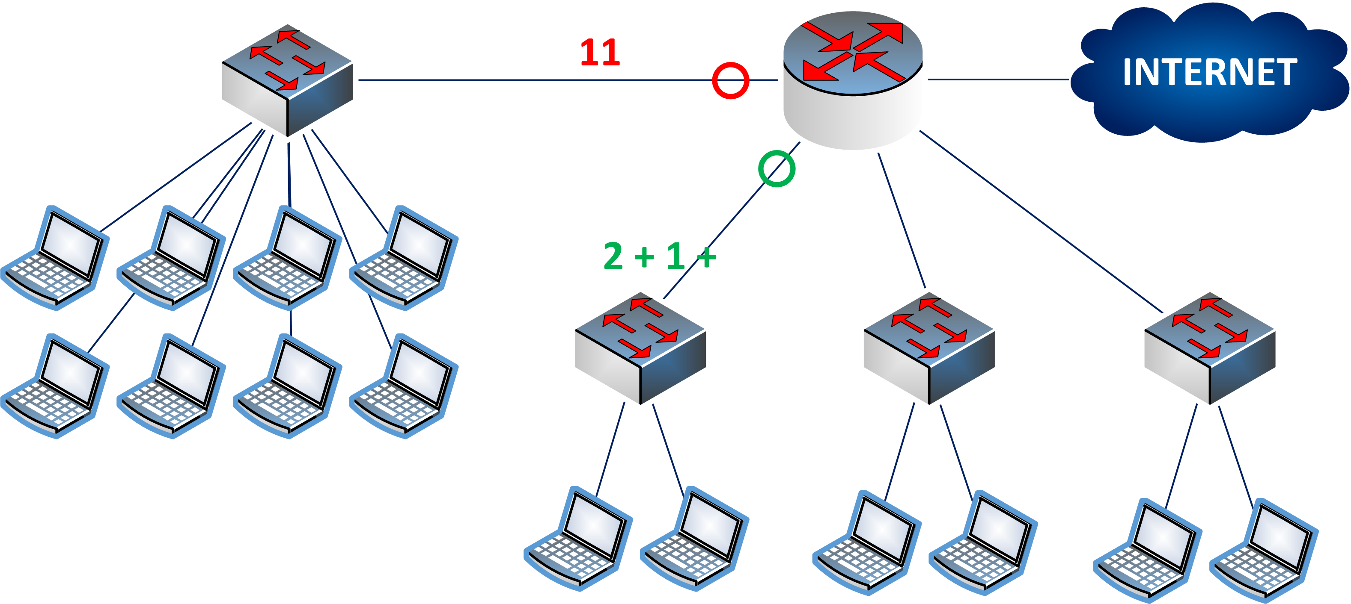
A Simple Example

Slide 20

A Simple Example

Slide 21

A Simple Example

Slide 22

A Simple Example

Slide 23

A Simple Example

Slide 24

A Simple Example

Slide 25

A Simple Example

Slide 26

A Simple Example

Slide 27

A Simple Example

Slide 28
A Simple Example
Request: create 4 subnets, where 3 subnets should have 5 IP addresses each, and 1 subnet needs 11 addresses.

Slide 29
A Simple Example
Request: create 4 subnets, where 3 subnets should have 5 IP addresses each, and 1 subnet needs 11 addresses.
Solution:

Slide 30
A Simple Example
Request: create 4 subnets, where 3 subnets should have 5 IP addresses each, and 1 subnet needs 11 addresses.
Solution:
Subnet | Number of hosts | Mask | Network ID | Range of ‘useful’ addresses
#1 | 11 | /28 | 192.168.1.0 | 192.168.1.1 – 192.168.1.14
#2 | 5 | /28 | 192.168.1.16 | 192.168.1.17 – 192.168.1.30
#3 | 5 | /28 | 192.168.1.32 | 192.168.1.33 – 192.168.1.46
#4 | 5 | /28 | 192.168.1.48 | 192.168.1.49 – 192.168.1.62

Slide 31
A Simple Example
Request: create 4 subnets, where 3 subnets should have 5 IP addresses each, and 1 subnet needs 11 addresses.
Solution:
Subnet

Slide 32
A Simple Example
Request: create 4 subnets, where 3 subnets should have 5 IP addresses each, and 1 subnet needs 11 addresses.
Solution:
Subnet
#1
#2
#3
#4

Slide 33
A Simple Example
Request: create 4 subnets, where 3 subnets should have 5 IP addresses each, and 1 subnet needs 11 addresses.
Solution:
Subnet | Number of hosts
#1
#2
#3
#4

Slide 34
A Simple Example
Request: create 4 subnets, where 3 subnets should have 5 IP addresses each, and 1 subnet needs 11 addresses.
Solution:
Subnet | Number of hosts
#1 | 11
#2
#3
#4

Slide 35
A Simple Example
Request: create 4 subnets, where 3 subnets should have 5 IP addresses each, and 1 subnet needs 11 addresses.
Solution:
Subnet | Number of hosts
#1 | 11
#2 | 5
#3 | 5
#4 | 5

Slide 36
A Simple Example
Request: create 4 subnets, where 3 subnets should have 5 IP addresses each, and 1 subnet needs 11 addresses.
Solution:
Subnet | Number of hosts | Mask
#1 | 11
#2 | 5
#3 | 5
#4 | 5

Slide 37
A Simple Example
Request: create 4 subnets, where 3 subnets should have 5 IP addresses each, and 1 subnet needs 11 addresses.
Solution:
Subnet | Number of hosts | Mask
#1 | 11 | /28
#2 | 5
#3 | 5
#4 | 5

Slide 38
A Simple Example
Request: create 4 subnets, where 3 subnets should have 5 IP addresses each, and 1 subnet needs 11 addresses.
Solution:
Subnet | Number of hosts | Mask
#1 | 11 | /28
#2 | 5 | /28
#3 | 5 | /28
#4 | 5 | /28

Slide 39
A Simple Example
Request: create 4 subnets, where 3 subnets should have 5 IP addresses each, and 1 subnet needs 11 addresses.
Solution:
Subnet | Number of hosts | Mask | Network ID
#1 | 11 | /28
#2 | 5 | /28
#3 | 5 | /28
#4 | 5 | /28

Slide 40
A Simple Example
Request: create 4 subnets, where 3 subnets should have 5 IP addresses each, and 1 subnet needs 11 addresses.
Solution:
Subnet | Number of hosts | Mask | Network ID | Range of ‘useful’ addresses
#1 | 11 | /28
#2 | 5 | /28
#3 | 5 | /28
#4 | 5 | /28

Slide 41
A Simple Example
Request: create 4 subnets, where 3 subnets should have 5 IP addresses each, and 1 subnet needs 11 addresses.
Solution:
Subnet | Number of hosts | Mask | Network ID | Range of ‘useful’ addresses
#1 | 11 | /28 | 192.168.1.0
#2 | 5 | /28
#3 | 5 | /28
#4 | 5 | /28

Slide 42
A Simple Example
Request: create 4 subnets, where 3 subnets should have 5 IP addresses each, and 1 subnet needs 11 addresses.
Solution:
Subnet | Number of hosts | Mask | Network ID | Range of ‘useful’ addresses
#1 | 11 | /28 | 192.168.1.0 | 192.168.1.1 – 192.168.1.14
#2 | 5 | /28
#3 | 5 | /28
#4 | 5 | /28

Slide 43
A Simple Example
Request: create 4 subnets, where 3 subnets should have 5 IP addresses each, and 1 subnet needs 11 addresses.
Solution:
Subnet | Number of hosts | Mask | Network ID | Range of ‘useful’ addresses
#1 | 11 | /28 | 192.168.1.0 | 192.168.1.1 – 192.168.1.14
#2 | 5 | /28 | 192.168.1.16
#3 | 5 | /28
#4 | 5 | /28

Slide 44
A Simple Example
Request: create 4 subnets, where 3 subnets should have 5 IP addresses each, and 1 subnet needs 11 addresses.
Solution:
Subnet | Number of hosts | Mask | Network ID | Range of ‘useful’ addresses
#1 | 11 | /28 | 192.168.1.0 | 192.168.1.1 – 192.168.1.14
#2 | 5 | /28 | 192.168.1.16 | 192.168.1.17 – 192.168.1.30
#3 | 5 | /28
#4 | 5 | /28

Slide 45
A Simple Example
Request: create 4 subnets, where 3 subnets should have 5 IP addresses each, and 1 subnet needs 11 addresses.
Solution:
Subnet | Number of hosts | Mask | Network ID | Range of ‘useful’ addresses
#1 | 11 | /28 | 192.168.1.0 | 192.168.1.1 – 192.168.1.14
#2 | 5 | /28 | 192.168.1.16 | 192.168.1.17 – 192.168.1.30
#3 | 5 | /28 | 192.168.1.32
#4 | 5 | /28

Slide 46
A Simple Example
Request: create 4 subnets, where 3 subnets should have 5 IP addresses each, and 1 subnet needs 11 addresses.
Solution:
Subnet | Number of hosts | Mask | Network ID | Range of ‘useful’ addresses
#1 | 11 | /28 | 192.168.1.0 | 192.168.1.1 – 192.168.1.14
#2 | 5 | /28 | 192.168.1.16 | 192.168.1.17 – 192.168.1.30
#3 | 5 | /28 | 192.168.1.32 | 192.168.1.33 – 192.168.1.46
#4 | 5 | /28

Slide 47
A Simple Example
Request: create 4 subnets, where 3 subnets should have 5 IP addresses each, and 1 subnet needs 11 addresses.
Solution:
Subnet | Number of hosts | Mask | Network ID | Range of ‘useful’ addresses
#1 | 11 | /28 | 192.168.1.0 | 192.168.1.1 – 192.168.1.14
#2 | 5 | /28 | 192.168.1.16 | 192.168.1.17 – 192.168.1.30
#3 | 5 | /28 | 192.168.1.32 | 192.168.1.33 – 192.168.1.46
#4 | 5 | /28 | 192.168.1.48

Slide 48
A Simple Example
Request: create 4 subnets, where 3 subnets should have 5 IP addresses each, and 1 subnet needs 11 addresses.
Solution:
Subnet | Number of hosts | Mask | Network ID | Range of ‘useful’ addresses
#1 | 11 | /28 | 192.168.1.0 | 192.168.1.1 – 192.168.1.14
#2 | 5 | /28 | 192.168.1.16 | 192.168.1.17 – 192.168.1.30
#3 | 5 | /28 | 192.168.1.32 | 192.168.1.33 – 192.168.1.46
#4 | 5 | /28 | 192.168.1.48 | 192.168.1.49 – 192.168.1.62

Slide 49
IP Subnetting – Zero to Hero Fixed-Length Subnet Mask (FLSM)
CyberQuince

